Slide 1

Library Management System
Group Members:
Siken Man Dongol
Mohammad Shamsh Tabrez Alam
Sagar Prasad Pandey

Slide 2
Introduction
Basic Desktop application for library management
File based system
Library User,member management system
Books repository

Slide 3
Features
User controlling mechanism
contains three types of user roles with different privileges.
Admin
Librarian
Both
Add, update delete the book and book copy
check out of books for library members
check out history maintenance of library members
Books repository
Library User and member management

Slide 4
Library Management System architecture
File Repository
Logic layer
System Controllers(login,book,member,etc.)
User Interface

Slide 5
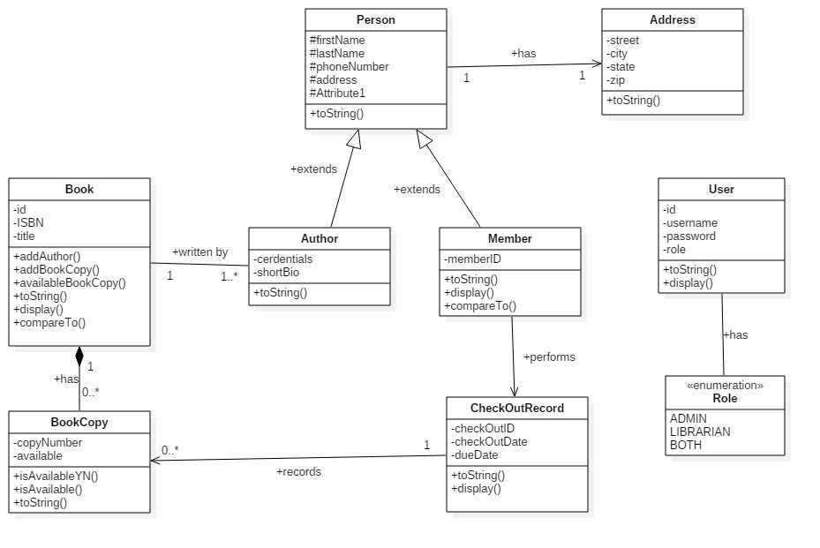
Class Diagram for LMS

Slide 6
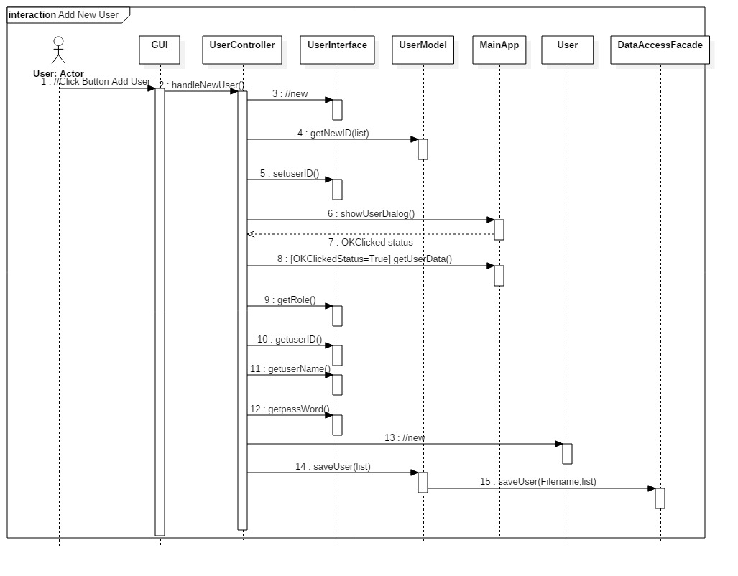
Sequence Diagram for adding new user in system

Slide 7
DEMO

Slide 8

Queries?????

